Slide 1
M-O,CRUD

Slide 2
How insert in realtion many to one
To insert usally creat Session and try catch in
Session.beginTransacation();
Creat object of class A (A is one to Many B)
Creat object of class B
Then set vaule for attribute and the realtion
SAVE Attribute for B in Class A and save attribute for A in B
example

Slide 3
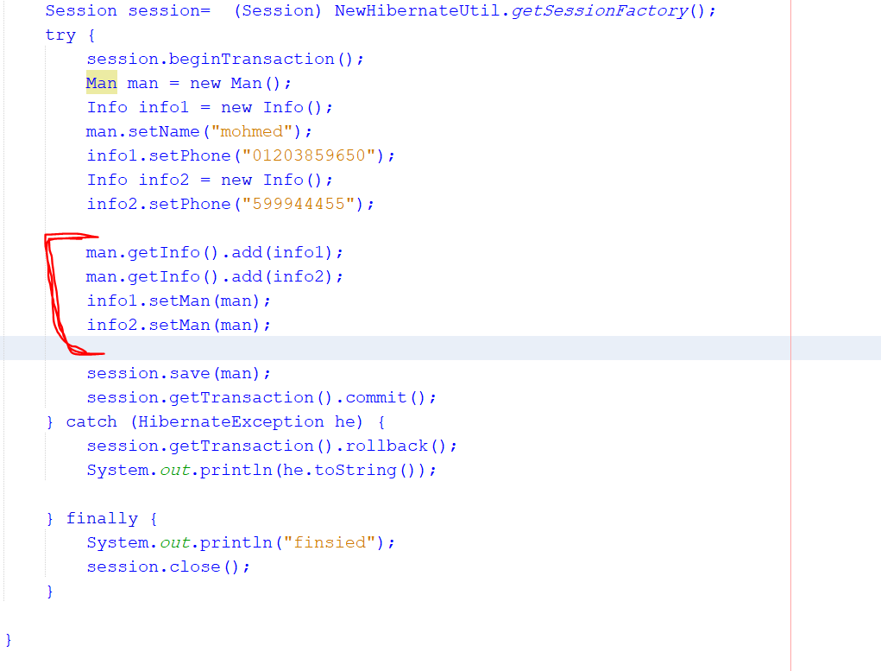

Slide 4
Select One to Many
Use seesion .get return object , assign the return to object
Return all data AS mappedBy in class A and Cascade
And print or do operation

Slide 5
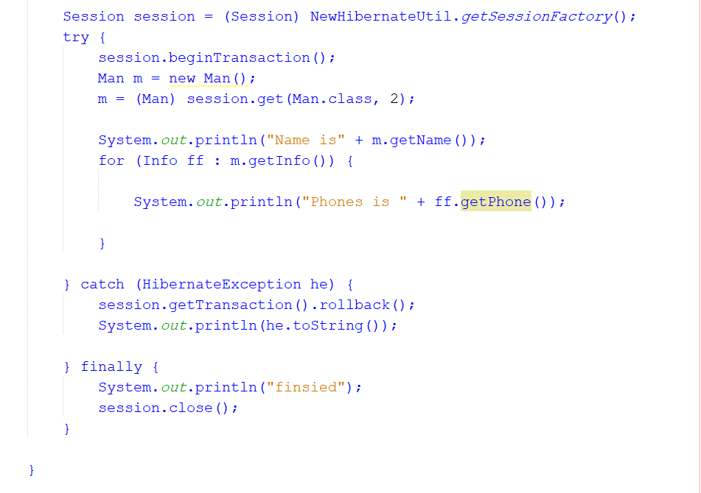

Slide 6
UPDAT
UPDATA= get data and insert new vaule with Same Object
Get with session.get() then assign object and add new vaule

Slide 7
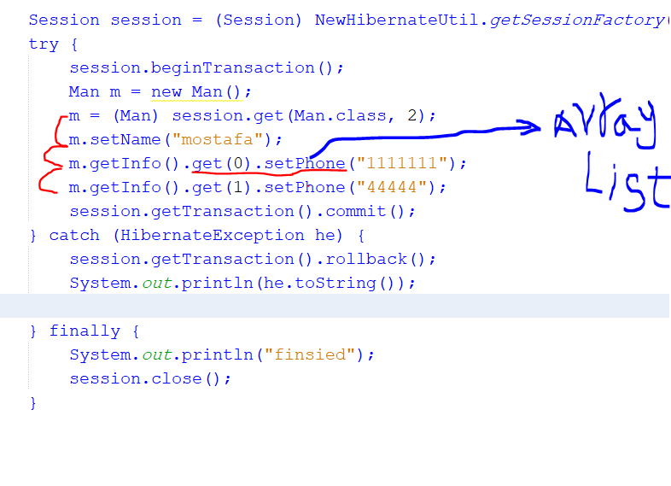
Use List To Insert New Value Easly for many object

Slide 8
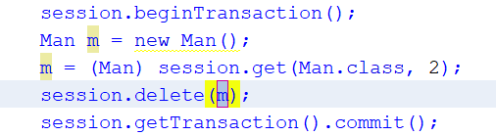
delete
Delete = get and delete
Delet all data from two table as use Cascade all if not use must delete forgin key frist and dalet table

